Slide 1
Binary Batch Distillation
Group 1
Joshua Olusoji, Omar Zaruk, Sanad Abu Hweij, Qussay Suleiman
Chemical Engineering Lab I
11/11/2025

Slide 2
Introduction
The objective of this experiment is to study the separation of an ethanol–water mixture using a batch distillation column by analyzing how reboiler duty and reflux ratio affect product composition, column efficiency, and overall separation performance.
The experiment determines the number of theoretical plates and column efficiency at various operating conditions by measuring pressure drops, collecting distillate and bottoms samples, and using vapor–liquid equilibrium data with the Fenske equation to evaluate column behavior.

Slide 3
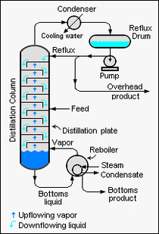
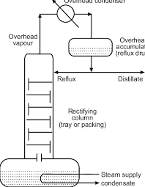
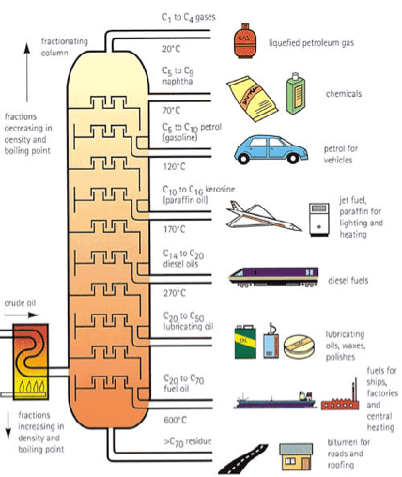
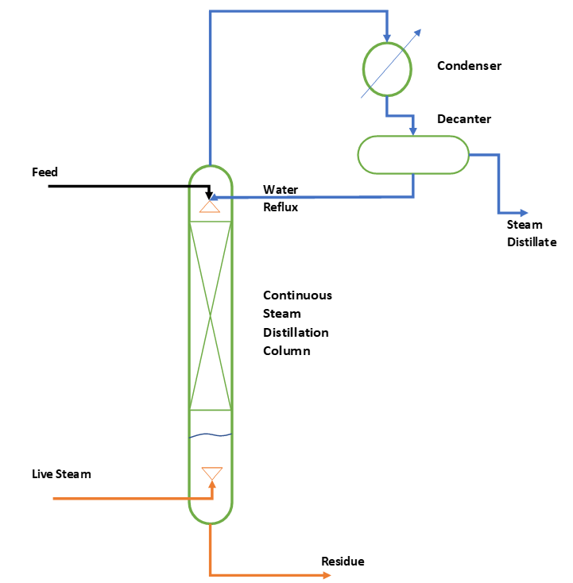
Theory
Types of Distillation
Continuous Distillation
Batch Distillation
Fractional Distillation
Steam Distillation
Obtained from Citizendium
Obtained from ResearchGate
Obtained from oilandgasinfo.ca
Obtained from ChemEnggHelp

Slide 4
Theory
Conditions
Experiment A – Total Reflux Operation
Column operated at total reflux → no distillate withdrawn
Increasing boil-up rate enhances vapor–liquid contact → higher separation efficiency
However, higher boil-up increases column pressure, which increases tray pressure drop
Excess pressure reduces efficiency, so there is an optimal boil-up rate for best performance
Experiment B – Partial Reflux Operation
Distillate is withdrawn while maintaining a controlled reflux ratio
Higher reflux ratio → increased internal liquid recycle → higher distillate purity
Trade-off: higher reflux ratio requires more energy and longer operating time

Slide 5
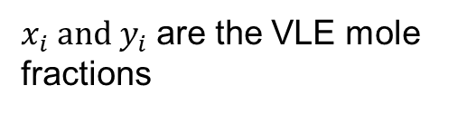
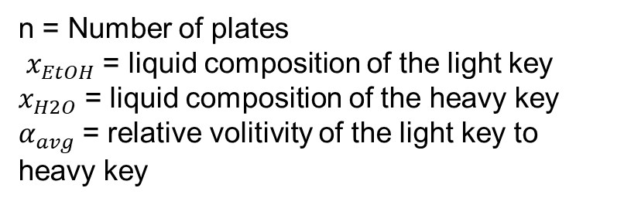
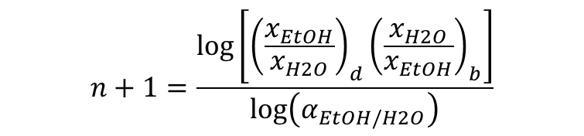

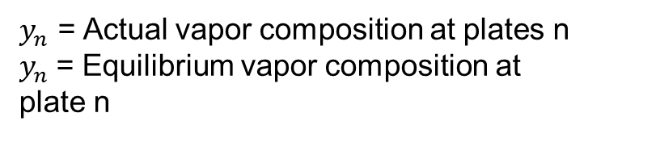


Theory
Equations
Fenske
Murphey Efficiency
$$n+1=\frac{\log\left[{\left(\frac{x_{EtOH}}{x_{H2O}}\right)}_{d}{\left(\frac{x_{H2O}}{x_{EtOH}}\right)}_{b}\right]}{\log\left(α_{EtOH/H2O}\right)}$$
$$η=\frac{y_{n}−y_{n+1}}{y_{n}^{∗}−y_{n+1}}$$
n = Number of plates
$x_{EtOH}$= liquid composition of the light key
$x_{H2O}$= liquid composition of the heavy key
$α_{avg}$= relative volitivity of the light key to heavy key
$y_{n}$ = Actual vapor composition at plates n
$y_{n}$= Equilibrium vapor composition at
plate n
Relative Volatility:
Vapor-Liquid Ratio:
Efficiency:
$$α_{EtOH/H2O}=\frac{K_{EtOH}}{K_{H2O}}$$
$$E=\frac{Theoretical Stages}{Actual Number of Trays}∗100\%$$
$K_{i}=\frac{y_{i}}{x_{i}}$
$x_{i} and{ y}_{i}$ are the VLE mole fractions

Slide 6
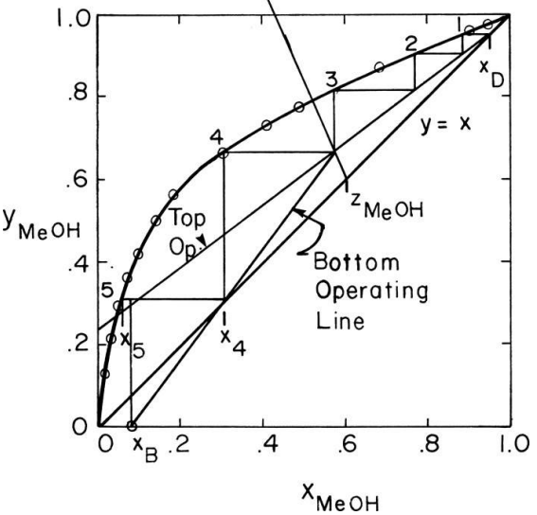
Theory
McCabe–Thiele Diagram
Graphical method used to determine the number of theoretical stages required for a desired separation
Based on vapor–liquid equilibrium (VLE) and mass balance relationships
The operating lines (rectifying + stripping) represent internal liquid/vapor flows in the column
Intersection with the equilibrium curve and stepping off stages gives the number of plates
Reflux ratio changes the slope of the rectifying operating line → higher reflux = fewer stages, higher energy
For Continuous Distillation
VLE is important in distillation because it governs how vapor and liquid compositions equilibrate at each stage, enabling separation.
McCabe–Thiele Diagram obtained from P. C. Wankat, Equilibrium-Staged Separations

Slide 7
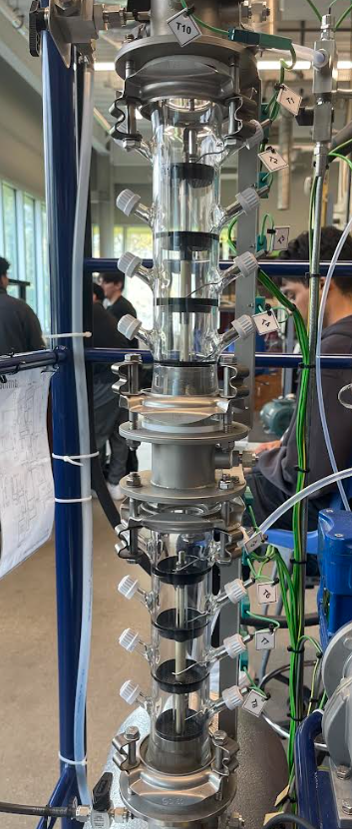
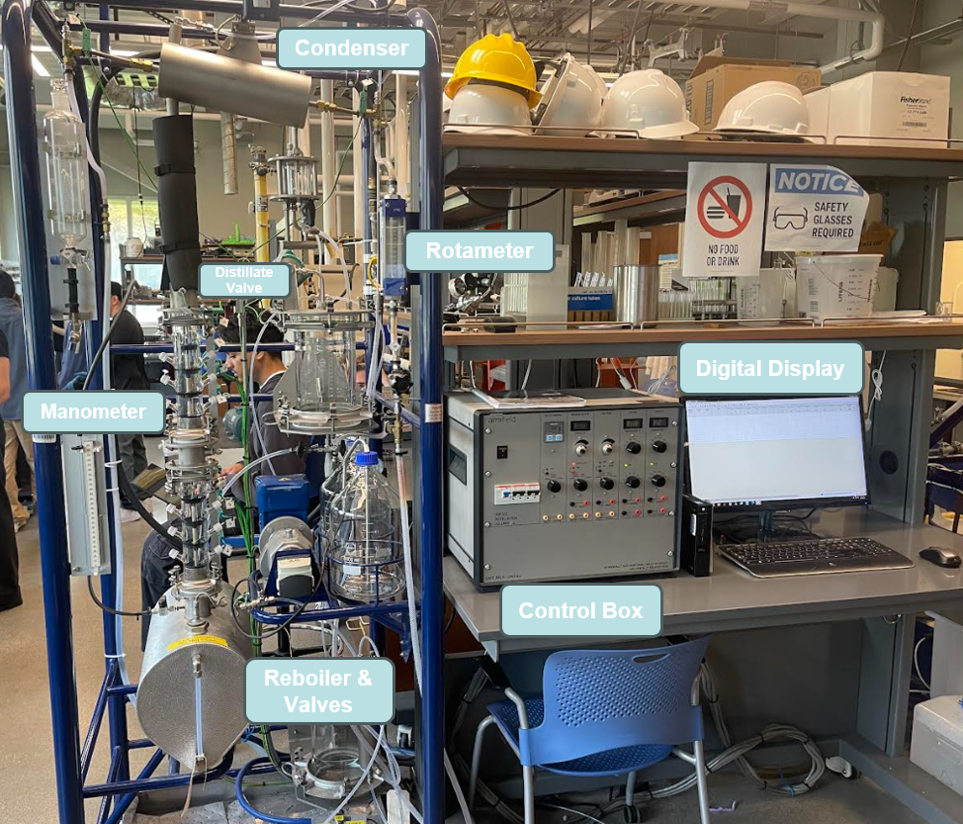
Apparatus
T1
T2
T3
T4
T5
T6
T7
T8

Slide 8
Material & Supplies
Stopwatch
4L Beaker
Snap-41 Densitometer
Test Tube Rack
Parafilm
Plastic Funnel
Heat resistant gloves
200-proof ethanol
Deionized Water

Slide 9
Procedure
Experiment A
Prepare a 10 L 10 wt% ethanol–water mixture (1.23 L EtOH + 8.77 L H₂O) and load it into the reboiler securely.
Start condenser cooling water at ~3 L/min (V5) and power on the control panel with the selector on T9 (Reboiler).
Begin heating at ~1.50 kW until the column floods, then reduce to ~0.75 kW once vapor flow stabilizes. Allow all tray temperatures (T1–T8) to reach steady state.
Measure the boil-up rate by diverting condensate through V3 (e.g., 8.2 mL in 7.84 s ≈ 3.75 L/hr) and record the manometer ΔP (open/close V6 & V7 briefly).
At 0.75 kW, 1.00 kW, and 1.25 kW, collect three sets of distillate and bottoms samples, then measure their compositions with the Snap 41 Densitometer and seal each with parafilm to minimize evaporation.

Slide 10
Procedure
Experiment B
Use the same ethanol–water charge and set the reboiler to ~0.75 kW under total reflux until bubbling is steady on all trays.
Program the reflux ratio on the control panel (e.g., 5:1) and switch the reflux valve ON to direct condensate between the receiver and column.
Measure the boil-up rate as before and take paired distillate (V3) and bottoms (V2) samples at steady state.
Repeat sampling every 5 minutes to collect three sets of data for each reflux ratio (e.g., 5:1 and 12:1). Record T1 and T8 for each run; cover samples with parafilm to prevent evaporation.
After completing both reflux-ratio runs, return to total reflux, allow steady state to re-establish, then power down and stop cooling water.

Slide 11
Experimental Challenges
The column took a long time to reach steady-state boiling, reducing available lab time and leaving little margin for error.
The thermocouple display (T1–T8) was initially unsynchronized, showing zero readings until the wires were reconnected and the program restarted.
Collecting top (distillate) and bottom samples required multiple operators for timing and valve control. With only two members, coordination delays caused small timing gaps between samples.
The Snap 41 densitometer occasionally failed to read due to bubbles or fast injection, causing slight evaporation losses.

Slide 12
Safety
To stay safe:
Wear nitrile gloves when handling ethanol to avoid skin contact and minimize exposure to vapors.
Use heat-resistant gloves when touching the reboiler, glass column, or valves to prevent burns from hot surfaces.
Avoid electrical hazards by keeping liquids away from the control console and computer; ensure cords and surfaces remain dry during operation.
Open manometer valves slowly and in the correct order to prevent vapor release or overpressurization of the column.

